Slide 1
Java advanced servlet
SAMAR MANSOUR

Slide 2
Concepts
What is Servlet
Servlet life cycle
Generic Servlet
HTTP Servlet

Slide 3
What is Servlet
Servlets are used to develop dynamic web applications.
Servlets are nothing but the Java programs which reside on the server side and their main purpose is to serve the client request.
Servlets are fully compatible with Java. You can use any of the available Java APIs like JDBC inside the servlets.
As servlets are written in Java, they are platform independent, robust, and secured.
In Servlets, a thread is created for each request unlike in CGI where a process is created for each request. Hence, servlets give better performance than CGI.
Servlets are protocol independent. i.e. they support FTP, SMTP, HTTP etc. protocols.

Slide 4
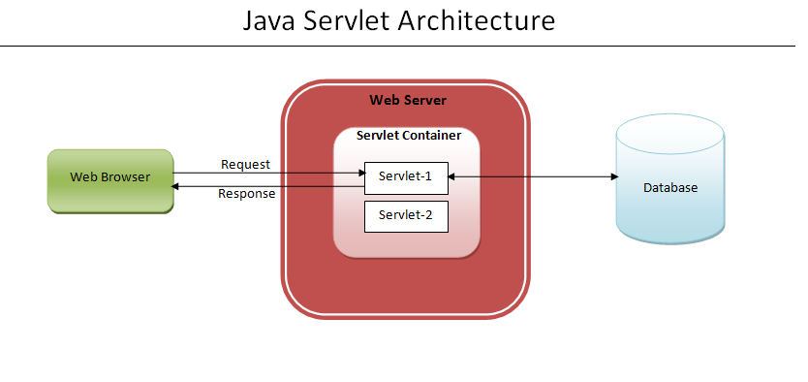

Slide 5
Features of Servlet
Portable:
Since java is platform independent, the same holds true for servlets. For example, you can create a servlet on Windows operating system that users GlassFish as web server and later run it on any other operating system like Unix, Linux with Apache tomcat web server, this feature makes servlet portable and this is the main advantage servlet has over CGI.
2. Efficient and scalable:
Once a servlet is deployed and loaded on a web server, it can instantly start fulfilling request of clients. The web server invokes servlet using a lightweight thread so multiple client requests can be fulling by servlet at the same time using the multithreading feature of Java. Compared to CGI where the server has to initiate a new process for every client request, the servlet is truly efficient and scalable.

Slide 6
Features of Servlet
3. Robust:
By inheriting the top features of Java (such as Garbage collection, Exception handling, Java Security Manager etc.) the servlet is less prone to memory management issues and memory leaks. This makes development of web application in servlets secure and less error prone.

Slide 7
Servlet life cycle
The web container maintains the life cycle of a servlet instance. Let's see the life cycle of the servlet:
Servlet class is loaded:
The classloader is responsible to load the servlet class. The servlet class is loaded when the first request for the servlet is received by the web container.
Servlet instance is created:
The web container creates the instance of a servlet after loading the servlet class. The servlet instance is created only once in the servlet life cycle.
init method is invoked:
The web container calls the init method only once after creating the servlet instance. The init method is used to initialize the servlet. It is the life cycle method of the javax.servlet.Servlet interface.
service method is invoked.
destroy method is invoked:
The web container calls the destroy method before removing the servlet instance from the service. It gives the servlet an opportunity to clean up any resource for example memory, thread etc.

Slide 8
Advantages Of Servlets
As servlets support all protocols like FTP, SMTP, HTTP etc. they can be used to develop any kind of web applications like E-commerce, Content management systems, chat based or file based web applications etc.
As servlets are fully compatible with Java, you can make use of wide range of available Java APIs inside the servlets.
As they run on Java enabled servers, You need not to worry about garbage collection and memory leaks. JVM handles them for you.
Since servlets are written in Java, they are portable and platform independent. You can run them on any operating systems and on any web servers available today.
Servlets inherit security features from JVM and web server.
As servlets are written in Java, you can extend them according to your requirements.
As servlets are compiled into bytecodes, they are faster than any other server-side scripting languages.

Slide 9
Generic Servlet
A generic servlet is a protocol independent Servlet that should always override the service() method to handle the client request.
The service() method accepts two arguments ServletRequest object and ServletResponse object.
The request object tells the servlet about the request made by client while the response object is used to return a response back to the client.

Slide 10
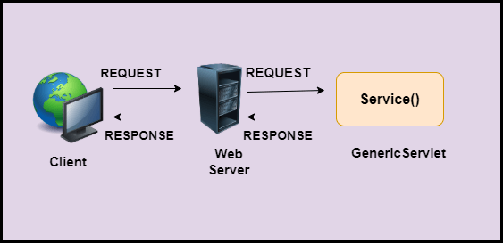
How GenericServlet works?

Slide 11
Advantages and Disadvantages of GenericServlet
Advantages
GenericServlet is easier to write.
To write it we just need to extend the class and override service() methods.
Disadvantages
It is not convenient to use the GenericServlet class.
It is not a safe approach to use Generic Servlet.

Slide 12
HTTP Servlet
Unlike Generic Servlet, the HTTP Servlet doesn’t override the service() method. Instead it overrides the doGet() method or doPost() method or both. The doGet() method is used for getting the information from server while the doPost() method is used for sending information to the server.
In Http Servlet there is no need to override the service() method because this method dispatches the Http Requests to the correct method handler, for example if it receives HTTP GET Request it dispatches the request to the doGet() method.

Slide 13
